Slide 1
Image
Notes:
[Sources]
- Πρότυπο: A4.M2 Πολυμέσα-Ήχος(2).pptx
[/Sources]

Slide 2


Today's lesson objectives
Apply filters to an image
Select the area that the filter will affect
Adjust a filter's settings
Save the final result
Notes:
[Sources]
- Θεωρία: pliroforiki_a_lykeiou_simeioseis_2023_2024(2).pdf, σελ. 82
[/Sources]

Slide 3

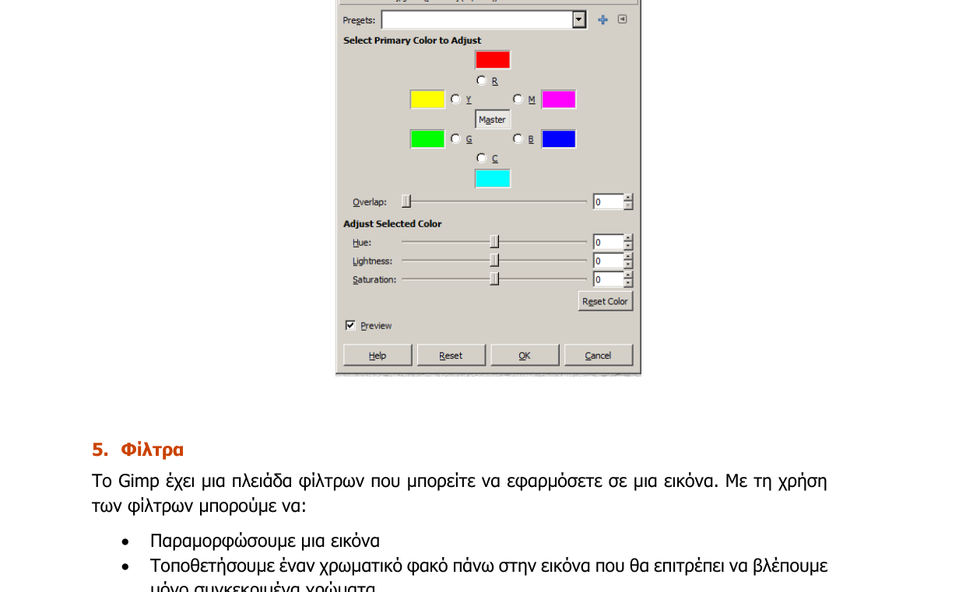
Filters in GIMP
Filters change the appearance of the whole image or a selected area.
They can distort, colour or correct a photograph.
They are available from the Filters menu.
Before applying a filter, carefully select the appropriate area.
Notes:
[Sources]
- Θεωρία: pliroforiki_a_lykeiou_simeioseis_2023_2024(2).pdf, σελ. 82
[/Sources]

Slide 4

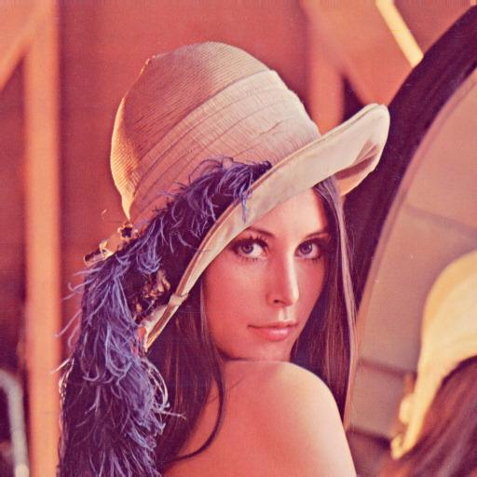

Pixelize
Select the face with a suitable selection tool
Filters → Blur → Pixelize
Select → None
Save as fe7_1.jpg
Original
Final
Notes:
[Sources]
- Ασκήσεις: pliroforiki_a_lykeiou_tetradio_ergasion_2023_2024(2).pdf, σελ. 63
[/Sources]

Slide 5

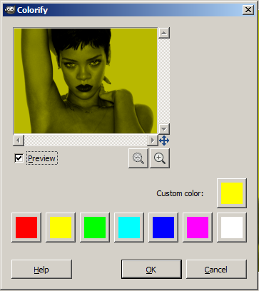

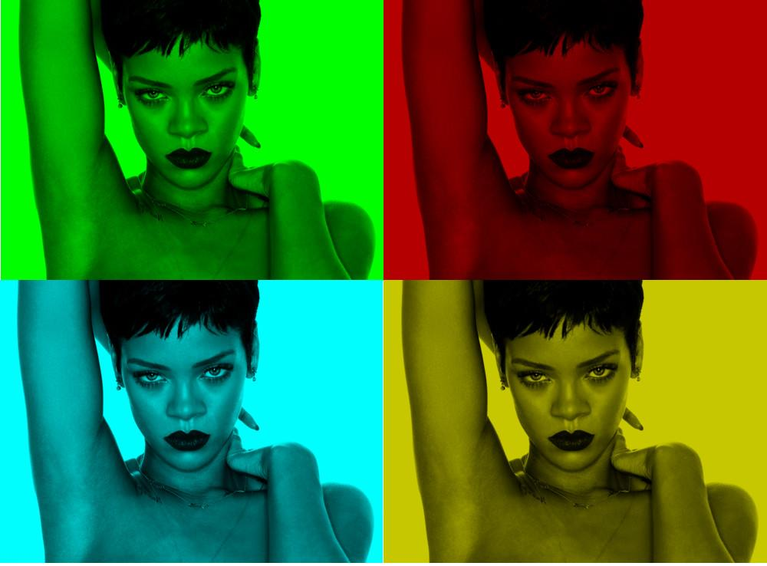
Colorify
Create a new 1000 × 738 image.
Choose Colors → Colorify and select a colour.
Copy the image four times.
Apply a different colour to each copy.
Notes:
[Sources]
- Ασκήσεις: pliroforiki_a_lykeiou_tetradio_ergasion_2023_2024(2).pdf, σελ. 64–65
[/Sources]

Slide 6
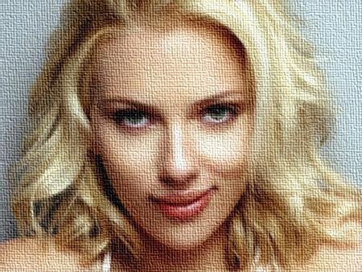
Van Gogh and Canvas
Filters → Artistic → Van Gogh
Adjust Saturation and the remaining settings.
Filters → Artistic → Apply Canvas
The combination creates the texture of a painting.
Notes:
[Sources]
- Ασκήσεις: pliroforiki_a_lykeiou_tetradio_ergasion_2023_2024(2).pdf, σελ. 65–66
[/Sources]

Slide 7
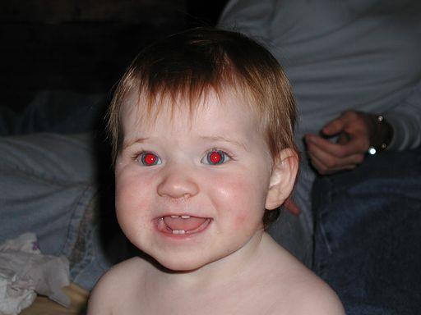

Red Eye Removal
Zoom in on the eye area.
Use Ellipse Select to select the first eye.
Hold Shift and select the second eye.
Filters → Enhance → Red Eye Removal
Choose Select → None and save the image.
Original
Final
Notes:
[Sources]
- Ασκήσεις: pliroforiki_a_lykeiou_tetradio_ergasion_2023_2024(2).pdf, σελ. 67–68
[/Sources]

Slide 8

Exercises
In class – Worksheet A.4.M7 (pp. 63–68)
A. Pixelize
B. Colorify
C. Van Gogh and Canvas
D. Red Eye Removal
Notes:
[Sources]
- Ασκήσεις: pliroforiki_a_lykeiou_tetradio_ergasion_2023_2024(2).pdf, σελ. 63–68
[/Sources]

